Slide 1
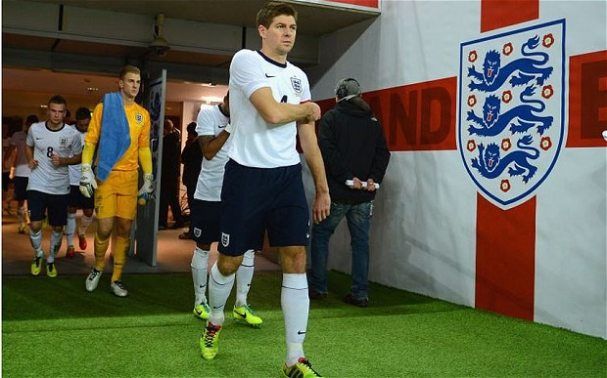

Time-varying uncertainty in macro
Nick Bloom (Stanford & NBER)
SED, June 26th 2014

Slide 2
Resurgence of uncertainty research since 2008
  Great Recession: accompanied by a spike in uncertainty, which many people argue is one factor driving the downturn
  “increased uncertainty is depressing investment by fostering an increasingly widespread wait-and-see attitude”
  FOMC minutes, April 2008
  At the same time the Great Moderation (1984-2007) ‘ended’ which had previously dampened business cycle research
  Faster computers: can run models with higher moments
  More data: high-frequency trading, surveys, text-search etc

Slide 3
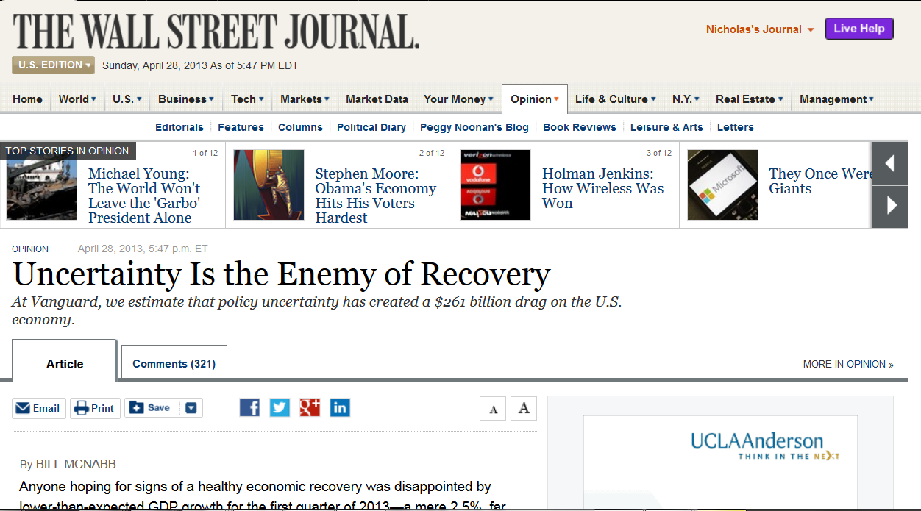

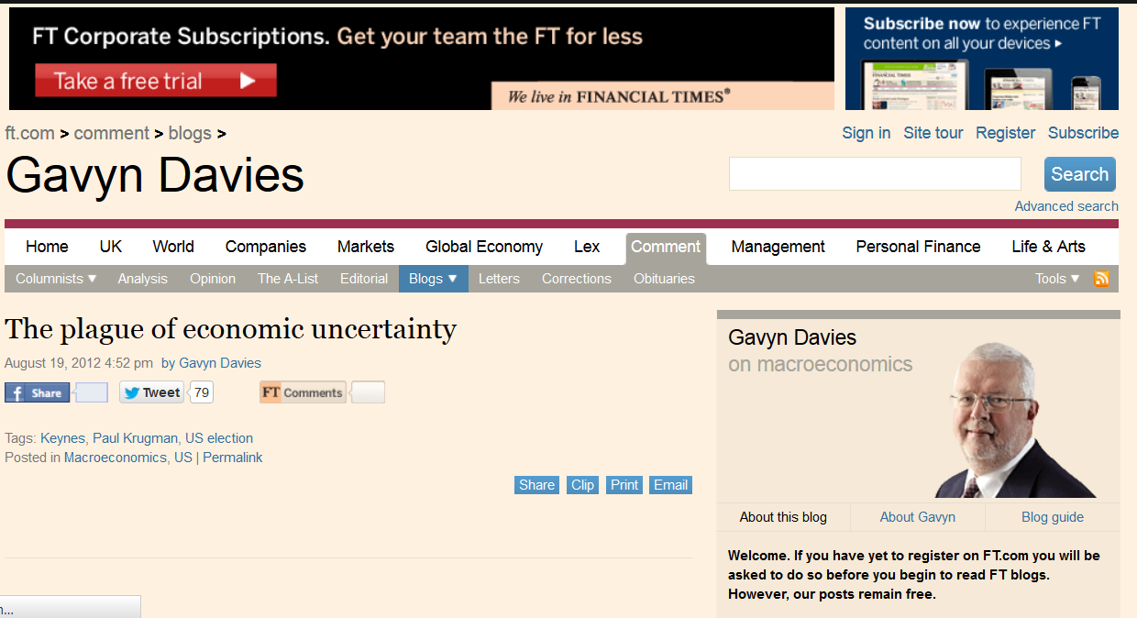
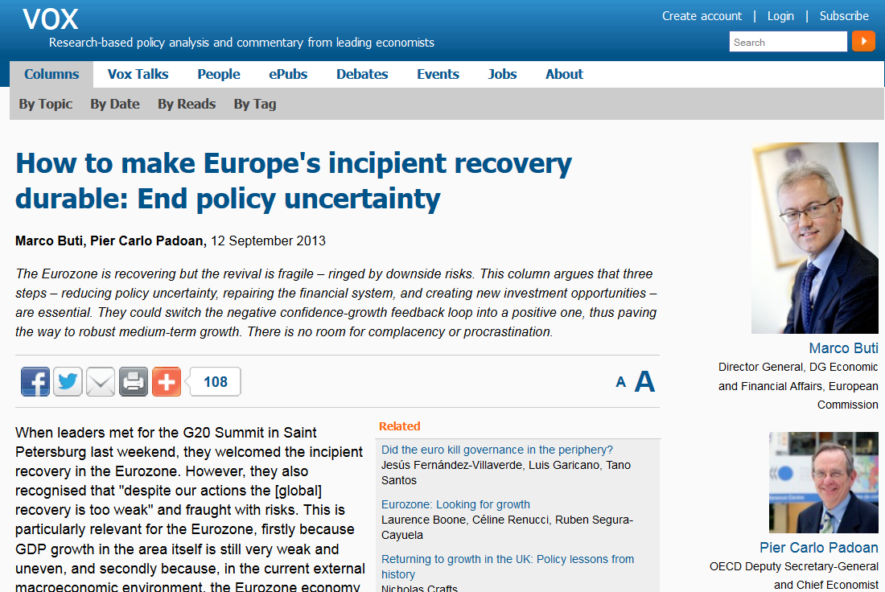

Uncertainty has also been in the media a lot

Slide 4
But for some people the best evidence that uncertainty matters is that….

Slide 5



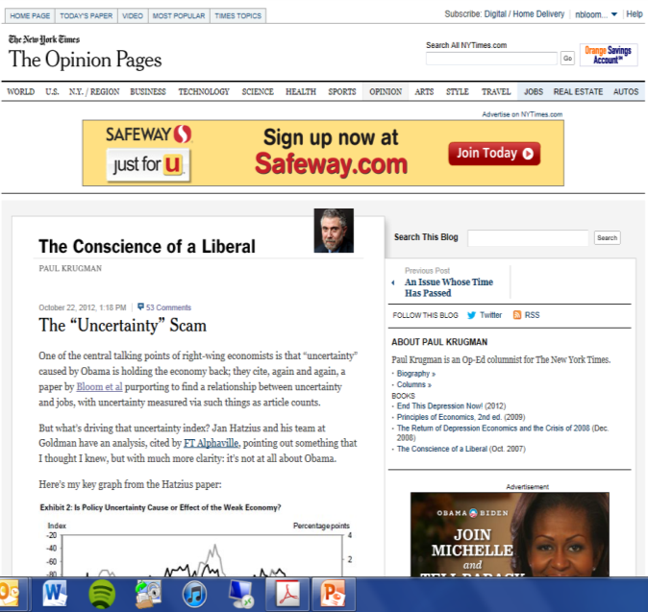

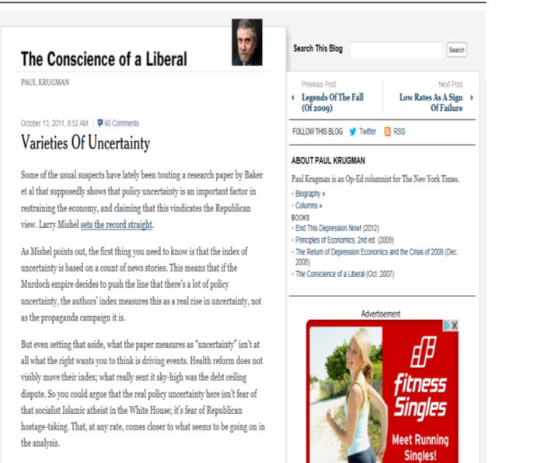

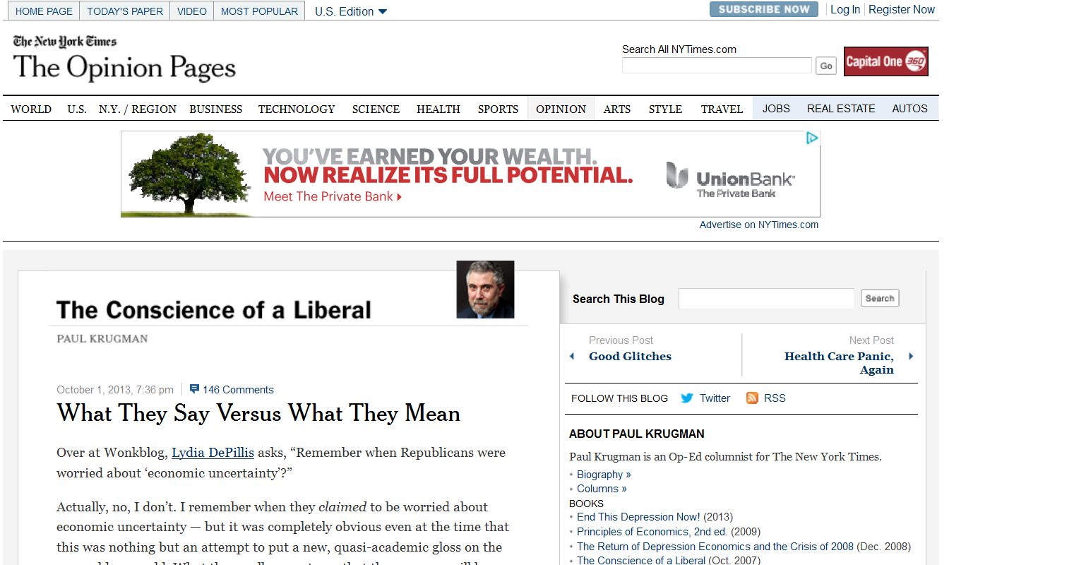
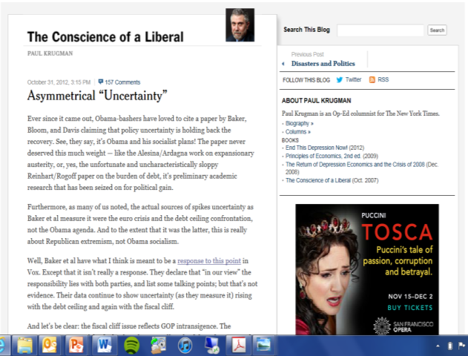
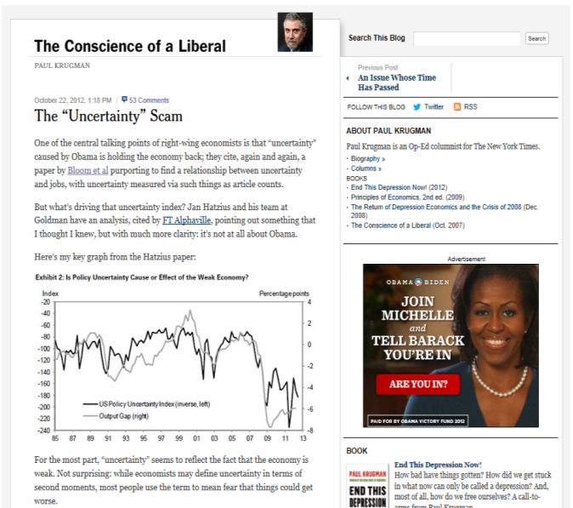
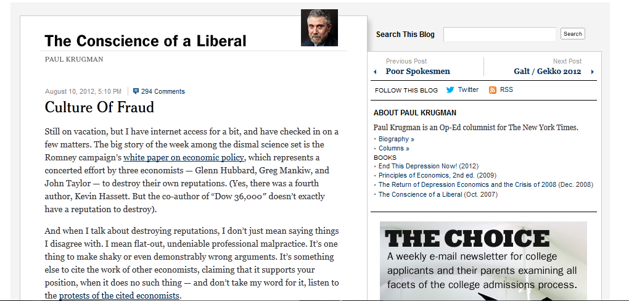
….Paul Krugman thinks it does not

Slide 6
Today I will discuss four areas briefly
  Theory: Generally in good shape, with a rich set of models identifying many channels of uncertainty impact
  Measurement: No one killer measure of uncertainty, but some stylized facts seem to be emerging
  Identification (causality): Less conclusive - my view is this goes in both directions: uncertainty ↔ growth
  Future work: Measurement, identification and computation

Slide 7
Theory
Measurement
Identification
Current work

Slide 8
Uncertainty needs curvature to matter
In completely linear systems no role for uncertainty,
  e.g. for U(C)=a+bC can simply use expected value of C
Likewise in log-linearized models can again just use certainty equivalence (e.g. Kydland & Prescott, 1982)
  Hence, in much of the early (pre-2000s) business-cycle literature uncertainty played little role

Slide 9
Wide range of potential sources of curvature, which are also theoretically ambiguous in sign
Negative Uncertainty Effects
- Adjustment costs (real options)
- Utility functions (risk-aversion)
- Financial frictions (lump-sum costs)
- Ambiguity (pessimism)
Positive Uncertainty Effects
- Production functions (Oi-Hartman-Abel effects)
- Bankruptcy (Growth options)

Slide 10
Wide range of potential sources of curvature, which are also theoretically ambiguous in sign
Negative Uncertainty Effects
- Adjustment costs (real options)
- Utility functions (risk-aversion)
- Financial frictions (lump-sum costs)
- Ambiguity (pessimism)
Positive Uncertainty Effects
- Production functions (Oi-Hartman-Abel effects)
- Bankruptcy (Growth options)

Slide 11
Real options literature emphasizes that many investment and hiring decisions are irreversible
Key early papers Bernanke (1983), McDonald & Siegel (1986), Bertola & Bentolila (1990), Dixit & Pindyck (1994)
Also idea behind my paper Bloom (2009) “Impact of uncertainty shocks” doing micro-macro in partial-equilibrium

Slide 12
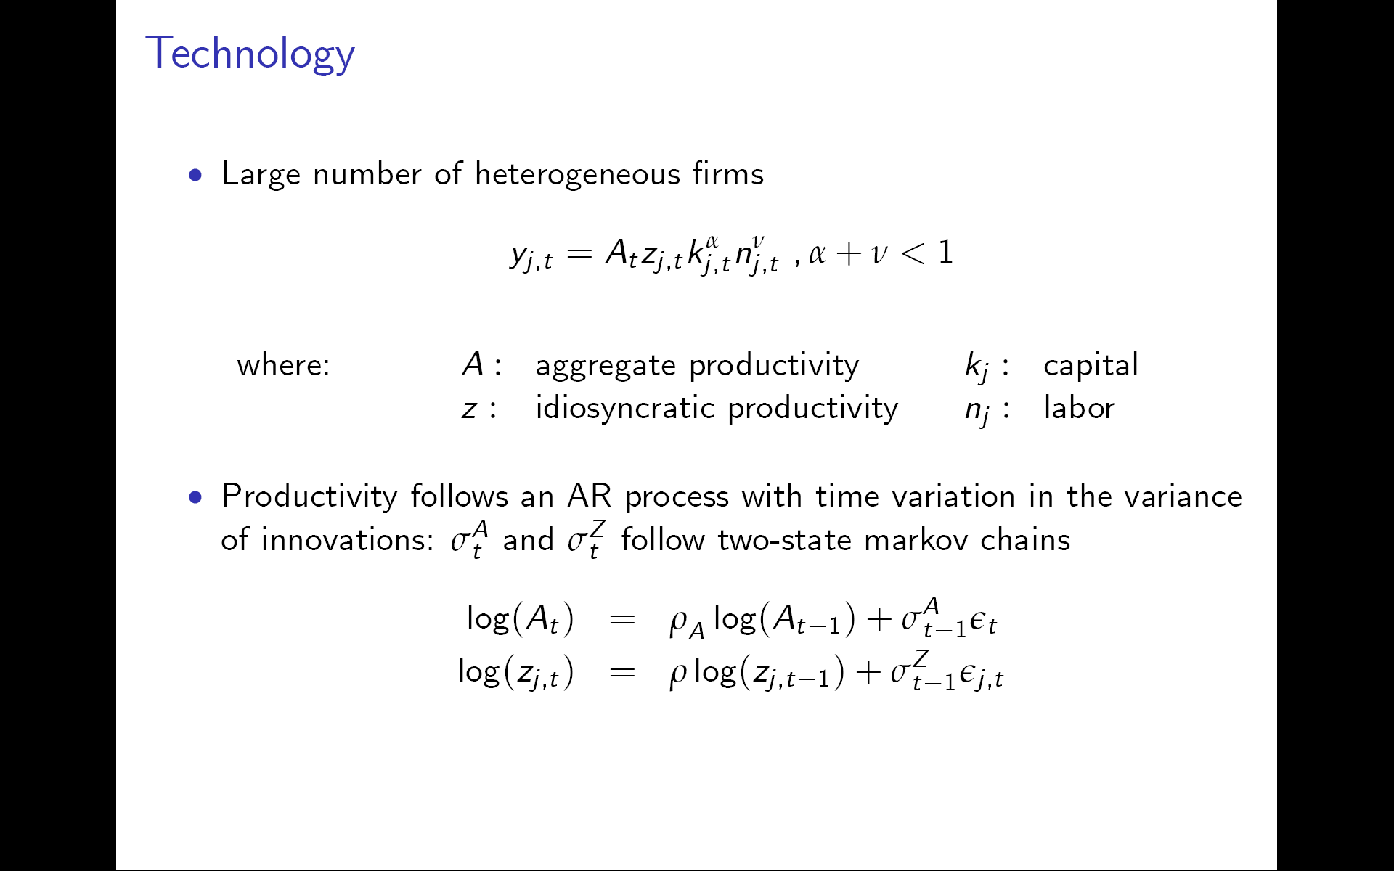
Summarize “Really uncertain business cycles” (Bloom, Floetotto, Jaimovich, Saporta & Terry, 2014)
Large number of heterogeneous firms
Macro productivity and micro productivity follow an AR process with time variation in the variance of innovations
Uncertainty (σ^{A} and σ^{Z}) persistent: 2-point markov chain

Slide 13
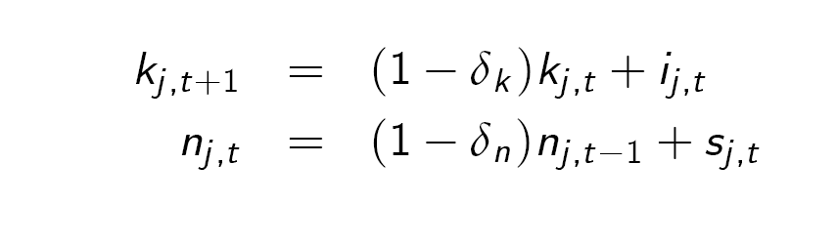
Capital and labor adjustment costs
Capital and labor follow the laws of motion:
where i: investment δ_{k}: depreciation
s: hiring δ_{n}: attrition
Allow for the full range of adjustment costs found in micro data
  Fixed – lump sum cost for investment and/or hiring
  Partial – per $ disinvestment and/or per worker hired/fired

Slide 14
For both investment and hiring this leads to Ss models with investment/disinvestment thresholds
Disinvest (s)
Invest (S)
Density of units
Innaction
Productivity / Capital
Disinvestment
Investment

Slide 15
Increased uncertainty makes the SS thresholds move outwards
Disinvest (s)
Invest (S)
Density of units
Innaction
Productivity / Capital

Slide 16
This leads net investment to fall, because investment drops more than disinvestment
Disinvest (s)
Invest (S)
Density of units
Productivity / Capital
Drop in disinvestment
Drop in investment

Slide 17
This leads to the:
“Delay effect”: higher uncertainty leads firms to postpone decisions. So net investment (and hiring) falls
∂I/∂σ<0 where I=investment or hiring, σ=uncertainty

Slide 18
Higher uncertainty also reduces responsiveness to stimulus (like prices, taxes and interest rates)
Disinvest (s)
Invest (S)
Density of units
Marginal investing density at low uncertainty threshold
Marginal investing density at high uncertainty threshold
Productivity / Capital

Slide 19
This leads to the :
“Delay effect”: higher uncertainty leads firms to postpone decisions. So net investment and hiring falls
∂I/∂σ<0 where I=investment or hiring, σ=uncertainty
“Caution effect”: higher uncertainty reduces firms response to other changes, like prices or TFP
∂²I/∂A∂σ<0 where I and σ as above, A=prices or TFP

Slide 20
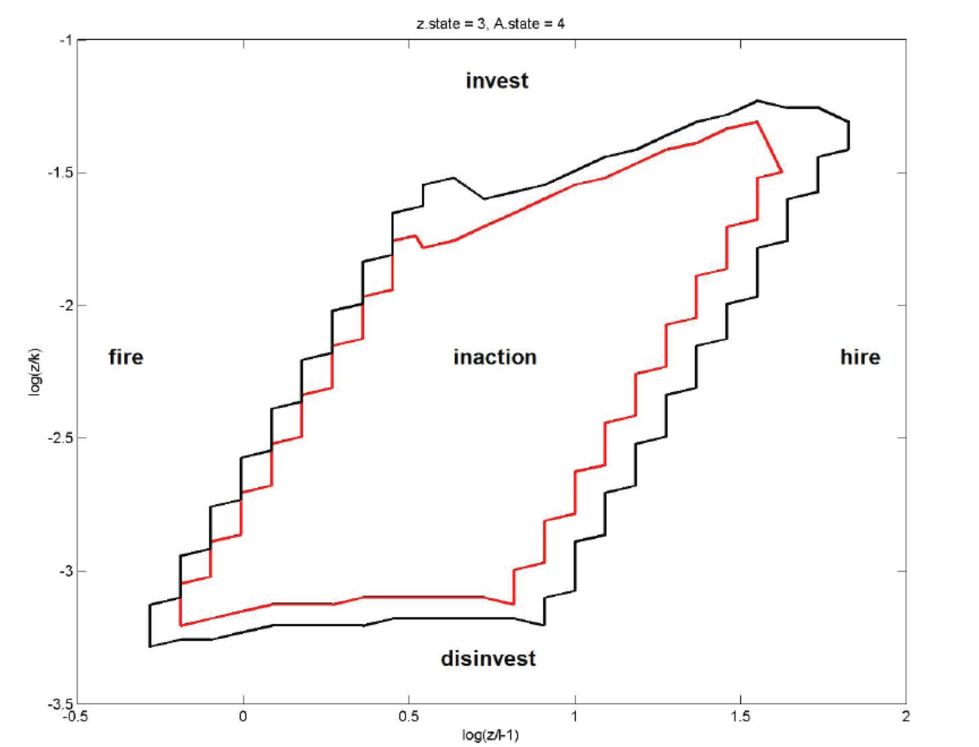
Since this model has 2-factors with adjustment costs it has a 2-dimensional response box
High uncertainty
Low uncertainty

Slide 21
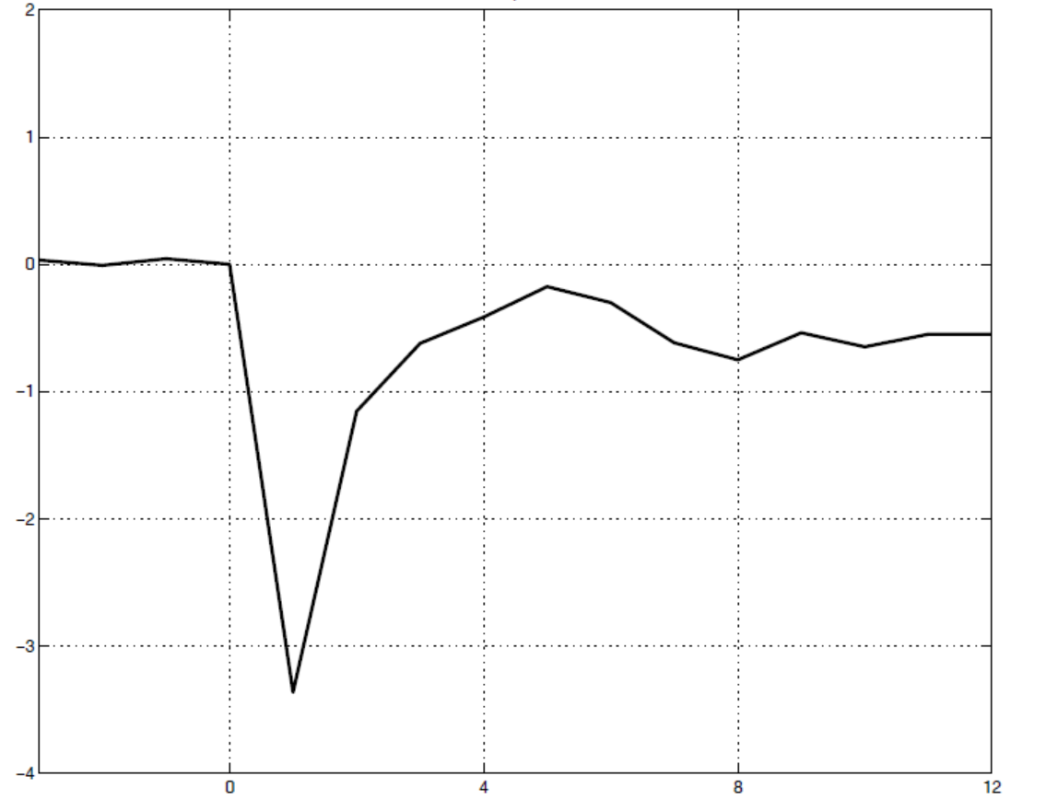
An uncertainty shock causes an output drop of about 3.5%, and a recovery to almost level within 1 year
Output deviation
(in logs from value in period 0)
Quarters (uncertainty shock in quarter 1)
Source: “Really Uncertain Business Cycles” by Bloom, Floetotto, Jaimovich, Saporta and Terry (2014)

Slide 22
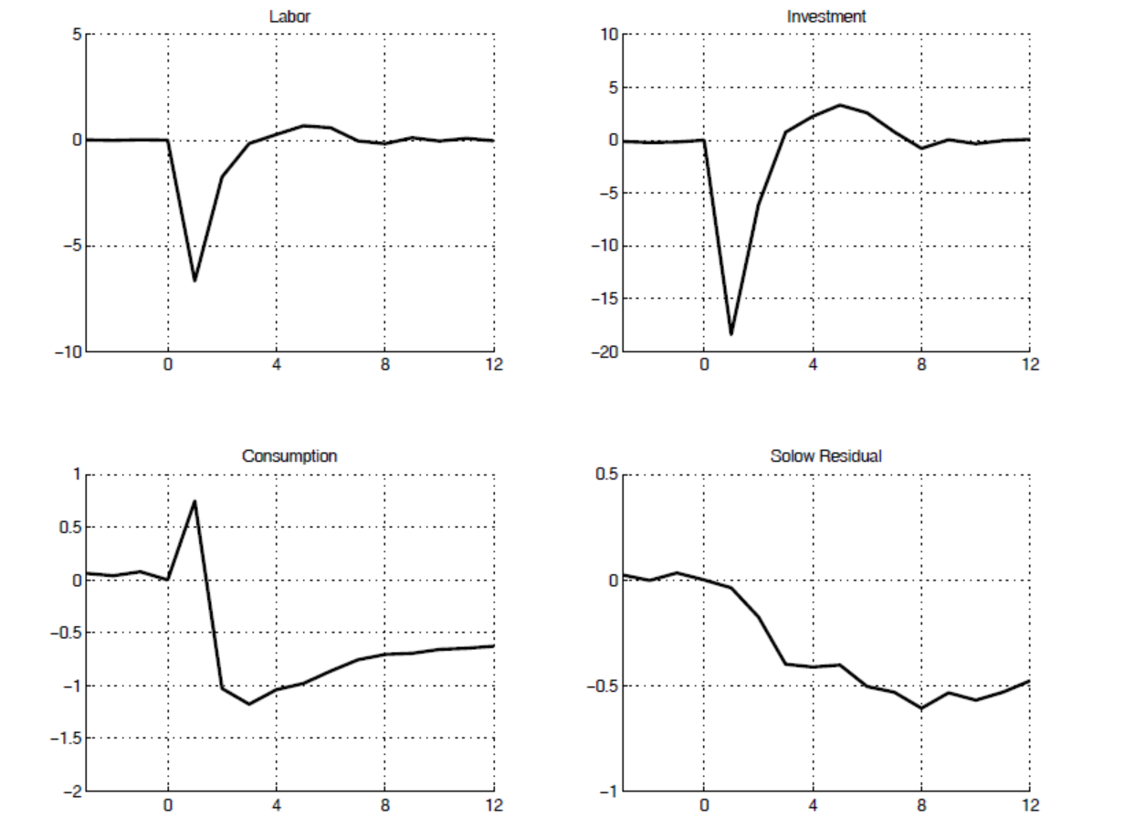
Labor and investment drop and rebound, while TFP slowly drops and rebounds
“Delay effect”
“Delay effect”
Deviation
(in logs from value in period 0)
Quarters (uncertainty shock in quarter 1)
“Caution effect”
Quarters (uncertainty shock in quarter 1)

Slide 23
How general are these results? Real option effects only arise under certain conditions
You can wait – rules out now or never situations (e.g. patent races, first-mover games, auctions etc)
Investing now reduces returns from investing later – rules out perfect competition and constant returns to scale
You can act ‘rapidly’ – rules out big delays, which Bar-Ilan & Strange (1996) show generate offsetting growth options
Requires non-convex adjustment costs – fixed or partial irreversibility (rather than only quadratic) adjustment costs

Slide 24
Theory
Measurement
Identification
Current work

Slide 25

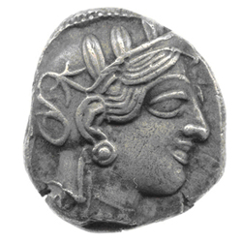
“Uncertainty” literature often rolls uncertainty & risk together, but theoretically they are distinct
Frank Knight (1921) defined:
Risk: A known probability distribution over events.
Example: A coin-toss
Uncertainty (Knightian): Unknown probability distribution
Example: Number of coins produced since 2000BC
In practice these are linked, so for simplicity I’ll refer to both as “uncertainty” (as has in fact most of the literature)

Slide 26
There are a number of proxies for uncertainty, that yield four stylized facts
Macro uncertainty appears countercyclical
Micro firm uncertainty appears countercyclical
Higher micro moments appear not to be cyclical?
Uncertainty is higher in developing countries

Slide 27
Stock returns realized volatility (back to 1950)
Volatility of the daily returns on the S&P 500
Source: Monthly volatility of the daily returns on the S&P500 at an annualized level. Grey bars are NBER recessions. Data spans 1950Q1-2013Q4.

Slide 28

VIX, the 1-month ahead implied S&P500 volatility
Source: VIX is the implied volatility on the S&P500, averaged to the quarterly level, provided by the Chicago Board of Options and Exchange. The VIX is the markets implied level of stock-market volatility over the next 30-days, where values are in standard-deviations on the S&P 500 at an annualized level. Grey bars are NBER recessions. Data spans 1990Q1-2013Q4.

Slide 29
Stock-volatility and VIX lead and lag the cycle
0
-.1
-.2
Correlation of stock volatility (or VIX) and
industrial production growth
-.3
vol correlation
-.4
vix correlation
-12
-11
-10
-9
-8
-7
-6
-5
-4
-3
-2
-1
0
1
2
3
4
5
6
7
8
9
10
11
12
Lead (lag if negative) months on volatility (or VIX)
Source: Industrial production monthly data from Federal Reserve Board data from 1970 onwards (VIX from 1990 onwards)

Slide 30
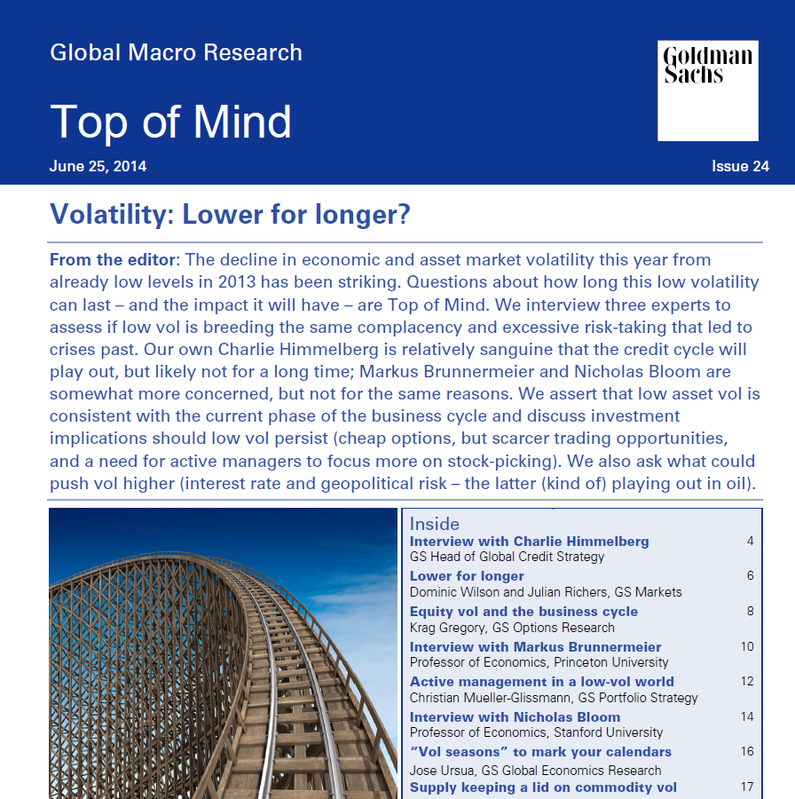
Interestingly, volatility now at very low levels

Slide 31

News-Based uncertainty indicators
US Newspapers:
Boston Globe
Chicago Tribune
Dallas Morning News
Los Angeles Times
Miami Herald
New York Times
SF Chronicle
USA Today
Wall Street Journal
Washington Post
Basic idea is to search for frequency of words like econom* and uncert* in newspapers

Slide 32
US Economic policy uncertainty
Debt Ceiling; Euro Debt
9/11
Shutdown
Lehman and TARP
Fiscal Cliff
250
Gulf War II
Gulf
War I
Bush Election
200
Black Monday
Russian Crisis/LTCM
Stimulus Debate
Clinton-Election
150
100
Euro Crisis and 2010 Midterms
50
1985
1987
1989
1991
1993
1995
1997
1999
2001
2003
2005
2007
2009
2011
2013
Source: “Measuring Economic Policy Uncertainty” by Scott R. Baker, Nicholas Bloom and Steven J. Davis, all data at www.policyuncertainty.com. Data normalized to 100 prior to 2010.

Slide 33
Policy Uncertainty also leads and lags the cycle
0
-.05
-.1
Correlation EPU & industrial production growth
-.15
-.2
-.25
-12
-11
-10
-9
-8
-7
-6
-5
-4
-3
-2
-1
0
1
2
3
4
5
6
7
8
9
10
11
12
Lead (lag if negative) months on policy uncertainty news index
Source: Economic Policy Uncertainty Index from www.policyuncertainty.com. Industrial production monthly data from Federal Reserve Board. Data from 1985 onwards.

Slide 34
News based measures are useful back in time
Lehman and TARP
Debt Ceiling
300
Great Depression, New Deal and FDR
Great Depression Relapse
Gulf War I
9/11 and Gulf War II
Gold Standard Act
Black Monday
Asian Fin. Crisis
Assassination of McKinley
Post-War Strikes, Truman-Dewey
OPEC II
Versailles conference
OPEC I
200
Start of WW I
Watergate
Policy Uncertainty Index
McNary Haughen farm bill
Berlin Conference
100
0
1900
1910
1920
1930
1940
1950
1960
1970
1980
1990
2000
2010
Notes: Index of Policy-Related Economic Uncertainty composed of quarterly news articles containing uncertain or uncertainty, economic or economy, and policy relevant terms (scaled by the smoothed total number of articles) in 5 newspapers (WP, BG, LAT, WSJ and CHT). Data normalized to 100 from 1900-2011.
Notes:
Political fighting:
Taft v Roosevelt over Conservatives vs Progressives in Republican Party (1910-1913)
The November 1912 spike is the election of Woodrow Wilson over Roosevelt (second) and Taft (third)
Close elections:
Wilson v Hughes in 1916
Truman vs Dewey in 1948
JFK-Nixon 1960
Major economics policies:
Woodrow Wilson’s New Freedom progressive agenda (1913-1921)
Calvin Coolidge (1923-29) – very laissez-faire and inactive (“no new experiments”), reduced size of government and debt, and “scientific taxation” (minimize tax changes – see http://en.wikipedia.org/wiki/Calvin_Coolidge)
New Deal 1932 plus last year under Hoover
JFK – New Frontier starts in 1960
LBJ – Great Society from 1964 (like New Frontier uses task forces of outsiders, including lots of economists…)

Slide 35
European Economic Policy Uncertainty Index
Papandreou calls for referendum, then resigns
Italy Rating Cut
Greek Bailout Request, Rating Cuts
200
Nice Treaty Referendum
9/11
Treaty of Accession/
Gulf War II
Lehman Bros.
Policy Uncertainty Index
Russian Crisis/LTCM
Northern Rock &
Ensuing
Financial
Turmoil
150
Asian
Crisis
Ongoing
Eurozone
Stresses
German
Elections
100
French and Dutch Voters
Reject European Constitution
50
1997
1998
1999
2000
2001
2002
2003
2004
2005
2006
2007
2008
2009
2010
2011
2012
2013
2014
Source: www.policyuncertainty.com. Based on 10 paper (El Pais, El Mundo, Corriere della Sera, La Repubblica, Le Monde, Le Figaro, the Financial Times, Times, Handelsblatt, FAZ.)

Slide 36
India Economic Policy Uncertainty Index
Exchange Rate Fluctuations and Worry
250
Lokpal Bill
Congress Party wins National Election
Lehman Bros
Price Hikes
200
India-US Nuclear Deal
Bear Sterns
India Based Policy Uncertainty Index
150
100
50
2003
2004
2005
2006
2007
2008
2009
2010
2011
2012
2013
2014
Source: www.policyuncertainty.com. Data from 7 Indian newspapers (Economic Times, Times of India, Hindustan Times, Hindu, Statesman, Indian Express, and Financial Express)

Slide 37
China Economic Policy Uncertainty Index
Political Transition and new National Congress
400
Eurozone Fears and Protectionism
Inflation and Export Pressure
300
9/11
China Deflation and Deficit
China Based Policy Uncertainty Index
200
Rising Interest Rates
China Stimulus
100
0
1995
1996
1997
1998
1999
2000
2001
2002
2003
2004
2005
2006
2007
2008
2009
2010
2011
2012
2013
2014
Source: www.policyuncertainty.com. Data until February 2014. Based on newspaper articles from the South China Morning Post.

Slide 38
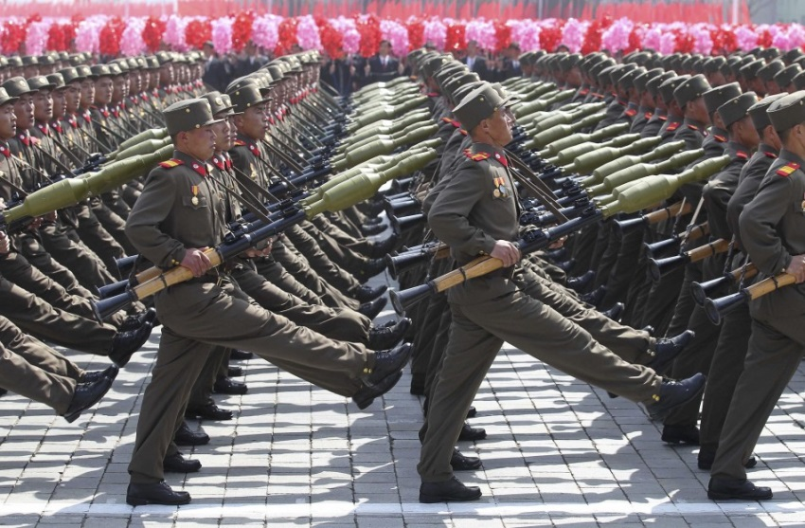
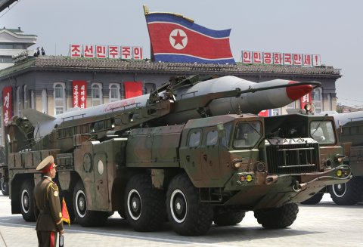
North Korean Economic Policy Uncertainty Index
250
200
Policy Uncertainty Index
150
100
50
2003
2004
2005
2006
2007
2008
2009
2010
2011
2012
2013
2014
Source: www.policyuncertainty.com. Data from 0 North Korean newspapers

Slide 39



Forecaster disagreement and uncertainty: GDP
Mean Forecast
GDP growth uncertainty and disagreement (same scale)
Forecaster disagreement
GDP growth (mean forecast )
Forecaster uncertainty
Notes: Data from the probability changes of GDP annual growth rates from the Philadelphia Survey of Professional Forecasters. Mean forecast is the average forecasters expected GDP growth rate, forecaster disagreement is the cross-sectional standard-deviation of forecasts, and forecaster uncertainty is the median within forecaster subjective variance. Data only available on a consistent basis since 1992 Q1, with an average of 48 forecasters per quarter. Data spans 1992-20013.

Slide 40
Econometric forecast uncertainty
12 months ahead macro forecast uncertainty
Source: Jurado, Ludvigson and Ng (2013). Forecasts from a bundle of 132 mostly macro series

Slide 41
Macro uncertainty appears countercyclical
Micro firm uncertainty appears countercyclical
Higher micro moments appear not to be cyclical?
Uncertainty is higher in developing countries

Slide 42
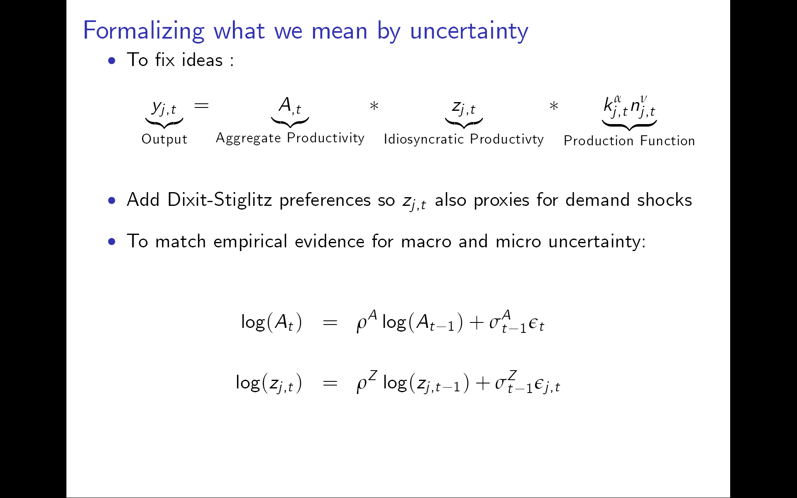
The economy is ‘fractal’ - micro uncertainty seems to rise at every level in recessions
Idiosyncratic shocks appear more volatile in recessions at all levels:
- industry
- firm
- plant
- product

Slide 43
Industry growth dispersion (by month)
99th percentile
95th percentile
90th percentile
75th percentile
50th percentile
25th percentile
Industry level quarterly output growth rate (%)
10th percentile
5th percentile
1st percentile
Note: 1st, 5th, 10th, 25th, 50th, 75th, 90th, 95th and 99th percentiles of 3-month growth rates of industrial production within each quarter. All 196 manufacturing NAICS sectors in the Federal Reserve Board database. Source: Bloom, Floetotto and Jaimovich (2009)

Slide 44
Firm growth dispersion (by quarter)
Across all firms
(+ symbol)
Inter Quartile range of sales growth rate
Across firms in a SIC2 industry
Note: Interquartile range of sales growth (Compustat firms). Only firms with 25+ years of accounts, and quarters with 500+ observations. SIC2 only cells with 25+ obs. SIC2 is used as the level of industry definition to maintain sample size. The grey shaded columns are recessions according to the NBER. Source: Bloom, Floetotto, Jaimovich, Saporta and Terry (2011)

Slide 45
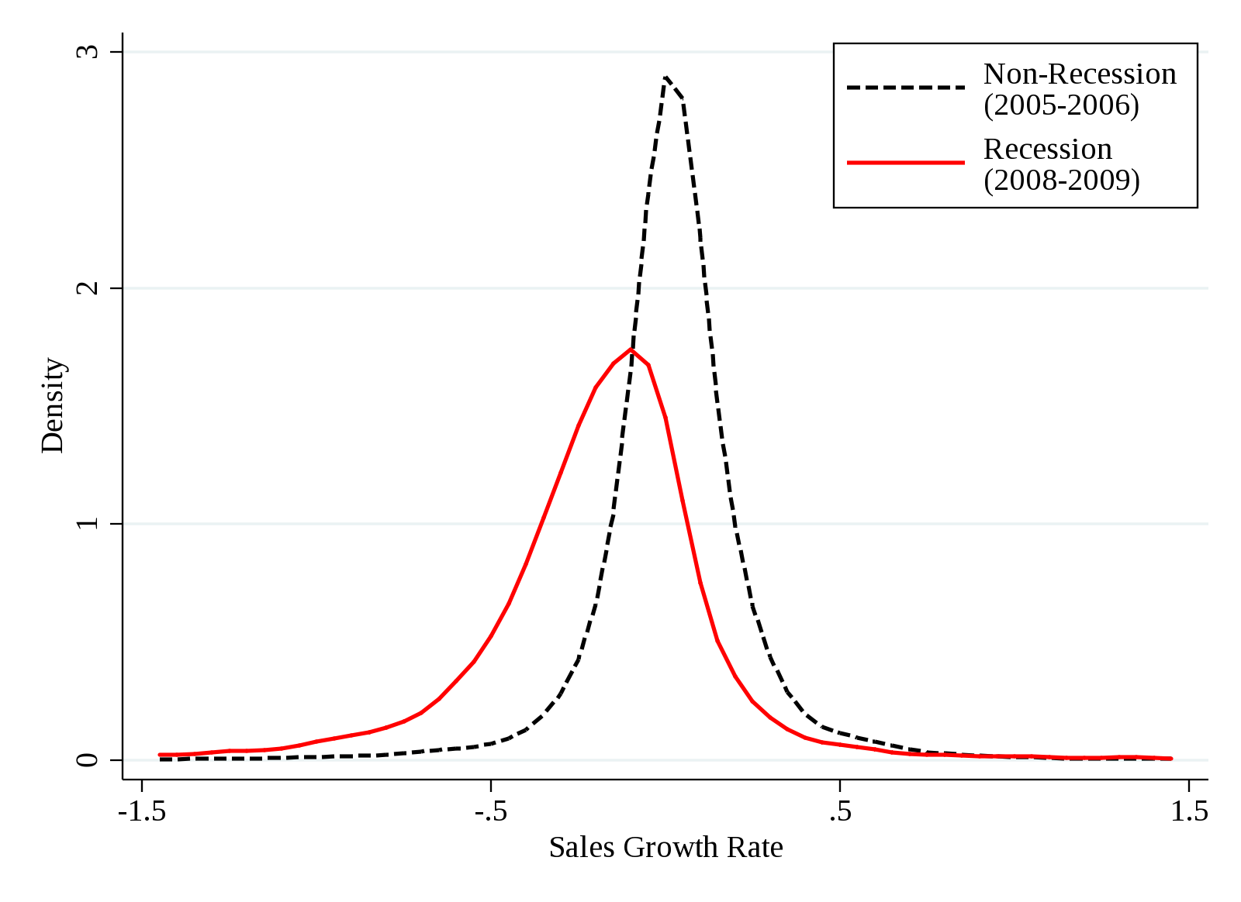
Plant growth dispersion pre & during great recession
Density
Sales growth rate
Source: “Really Uncertain Business Cycles” by Bloom, Floetotto, Jaimovich, Saporta and Terry (2012)
Notes: Constructed from the Census of Manufactures and the Annual Survey of Manufactures using a balanced panel of 15,752
establishments active in 2005-06 and 2008-09. Moments of the distribution for non-recession (recession) years are: mean 0.026
(-0.191), variance 0.052 (0.131), coefficient of skewness 0.164 (-0.330) and kurtosis 13.07 (7.66). The year 2007 is omitted because according to the NBER the recession began in December 2007, so 2007 is not a clean “before” or “during” recession year.
Notes:
I would make a big play of we saw 2008 and 2009 data as a test of this, and it appears to perform very well because of the huge surge. You could claim appears to be highest level yet in the data but checking into this….

Slide 46
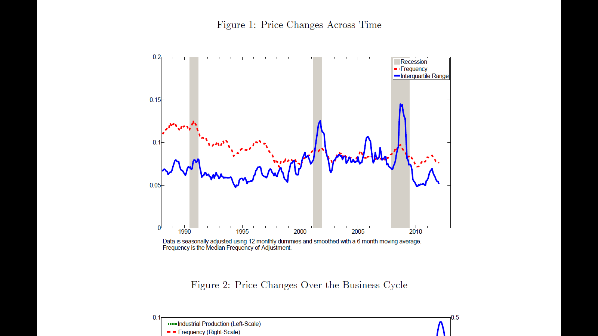
Product level price dispersion (by quarter)
Source: Joe Vavra (2014, QJE) “Inflation dynamics and time varying volatility”

Slide 47
Macro uncertainty appears countercyclical
Micro firm uncertainty appears countercyclical
Higher micro moments appear not to be cyclical?
Uncertainty is higher in developing countries

Slide 48
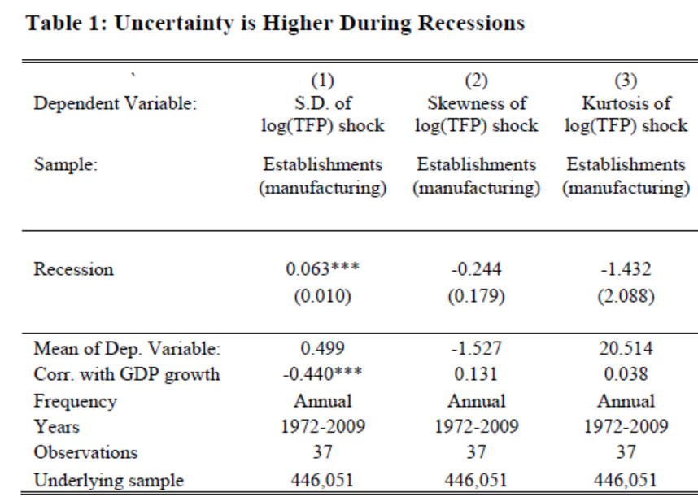
Higher moments harder to measure - need yet larger samples - but these suggest little cyclical behavior
Source: “Really Uncertain Business Cycles” by Bloom, Floetotto, Jaimovich, Saporta and Terry (2012)
Note: Annual Survey of Manufacturing establishments with 25+ years (to reduce sample selection). Shaded columns are share of quarters in recession. Source Bloom, Floetotto, Jaimovich, Saporta and Terry (2011).

Slide 49
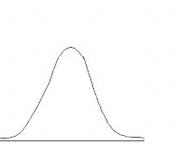

So in summary, in firms and plants we see
Normal distribution of TFP shocks
Recessionary distribution of TFP shocks

Slide 50
Earlier literature suggested income growth had a similar counter-cyclical second moment
Storesletten, Telmer & Yaron (2004) show US cohorts that lived through more recessions have more dispersed incomes
Meghir & Pistaferri (2004) show that labor market residuals have a higher standard deviation in recessions
Both used PSID which has about 20k individuals per year

Slide 51
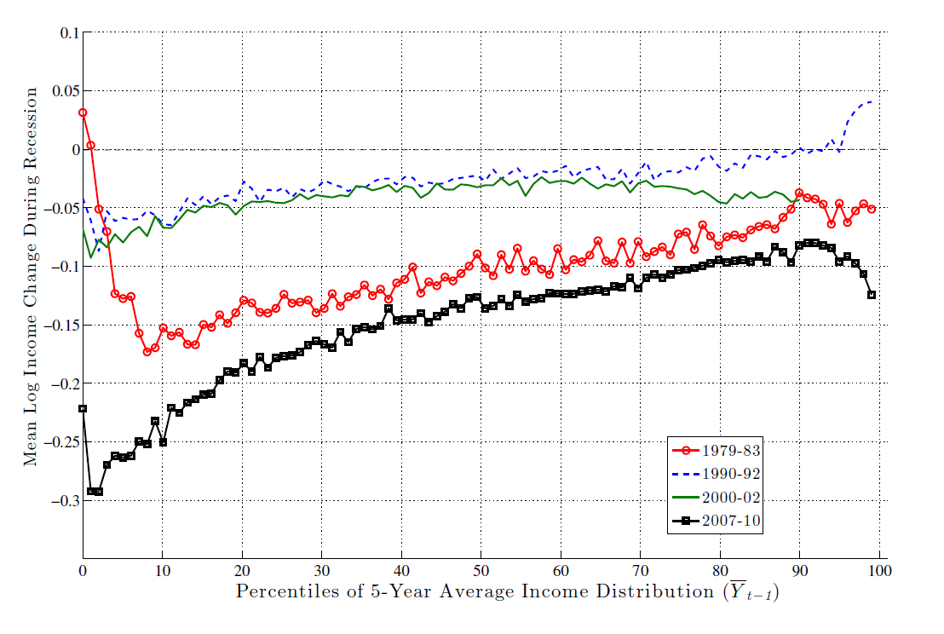
But SSA data on several million individuals shows rising 3rd moment but flat 2nd moment in recessions
Guvenen, Ozkan & Song, “The nature of countercyclical income risk” (2014, JPE)
Notes: Uses about 5m obs per year from the US Social Security Administration earnings data

Slide 52
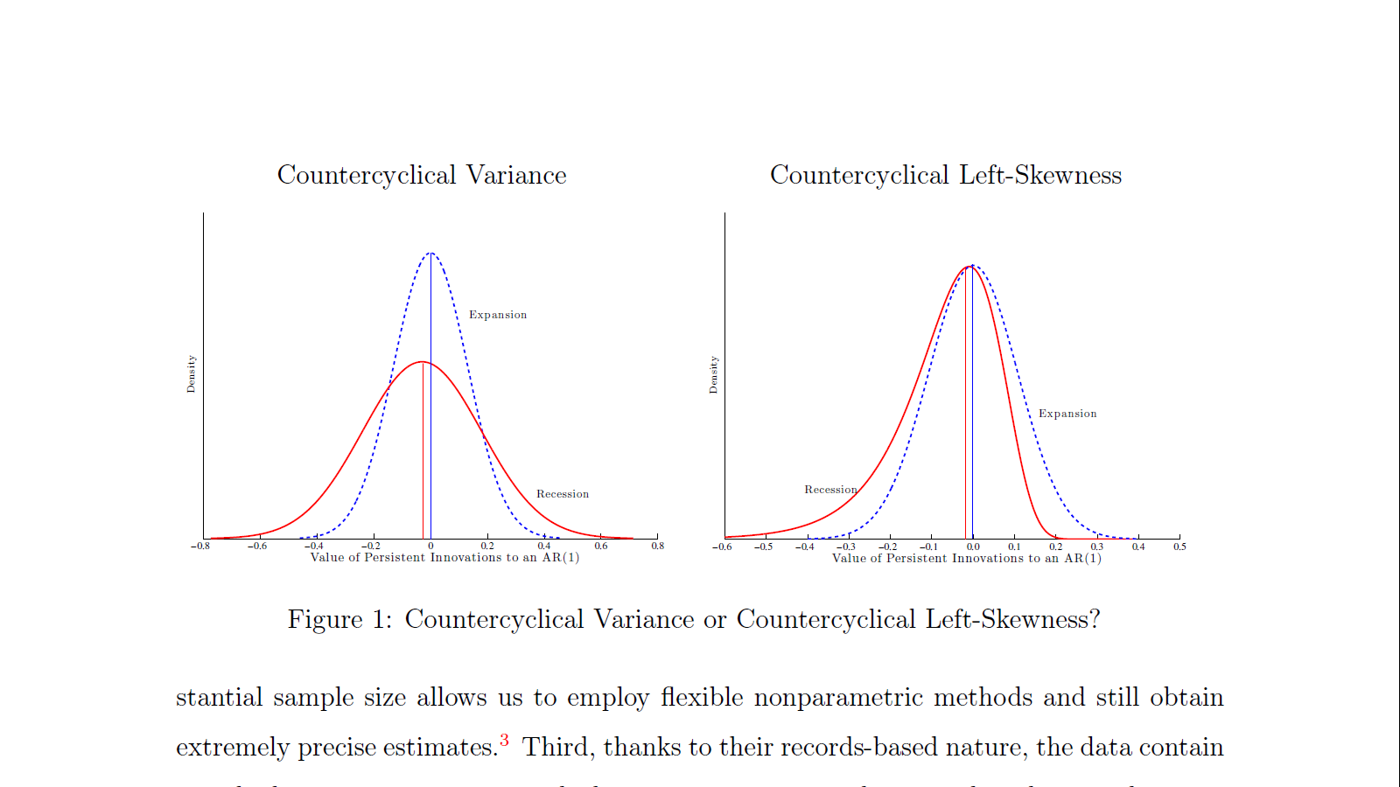
So firms and workers seem to differ in higher moments across recessions – not clear why?
Macro, industry, firms, plants and prices
Wages
Working with Jae Song, David Price and Fatih Guvenen to investigate (David is presenting this on Saturday at 11:30)

Slide 53
Macro uncertainty appears countercyclical
Micro firm uncertainty appears countercyclical
Firm skewness and kurtosis appear to be acyclical
Uncertainty is higher in developing countries

Slide 54
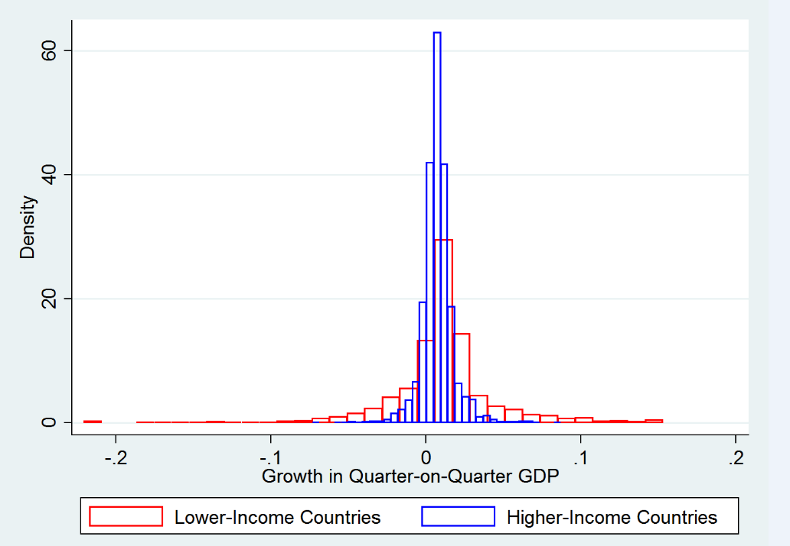
Developing countries about 50% more volatile GDP
Source: Baker & Bloom (2012) “Does uncertainty reduce growth? Evidence from disaster shocks”.
Notes: Rich=(GDP Per Capita>$20,000 in 2010 PPP)

Slide 55
Theory
Measurement
Identification (causality)
Current work

Slide 56
Question is what causes what?
Uncertainty
Focus of the theory discussed earlier and also my work (e.g. Bloom et al. 2014)
?
Recessions

Slide 57
Good reasons to worry about reverse causality, e.g.
“Krugman story”: recessions a good time for Governments to try new policies, as in Pastor and Veronesi (2012)
Learning: Fajgelbaum, Schaal & Taschereau-Dumouchel (2014) activity generating information, so recessions increase uncertainty and visa-versa (the “uncertainty trap”)
  builds on Van Nieuwerburgh and Veldkamp (2006)
Experiments: Bachmann and Moscarini (2011) recessions are good times to experiment
Forecasting: Orlik and Veldkamp (2014) argue recessions impede forecasting future outcomes

Slide 58
So what does the data say on causality?
It’s not conclusive - it suggests some causal impact of uncertainty, but the results are not “robust”

Slide 59
Micro papers on firms typically find negative association but struggle with causality, e.g.
Leahy & Whited (1996) regresses firm I/K on stock-return volatility, lags as instruments, find negative “delay effect”
(uncertainly lowers level of investment)
Bloom, Bond and Van Reenen (2007) use GMM on similar firm data, finding a negative “caution effect” (uncertainty makes firms less responsive)
But causality assumed via lags - not ideal as many variables are forward looking

Slide 60
Macro papers mostly pretty similar, e.g.
Ramey and Ramey (1995, AER) cross-country regression volatility on growth, using Government expenditure as an instrument for volatility, and find negative “delay effect”
Engel and Rangel (2008, RFS) update this using a larger cross-country panel and rich dynamics, again find a negative “delay effect” using lags for identification
But again not a particularly convincing causality story

Slide 61
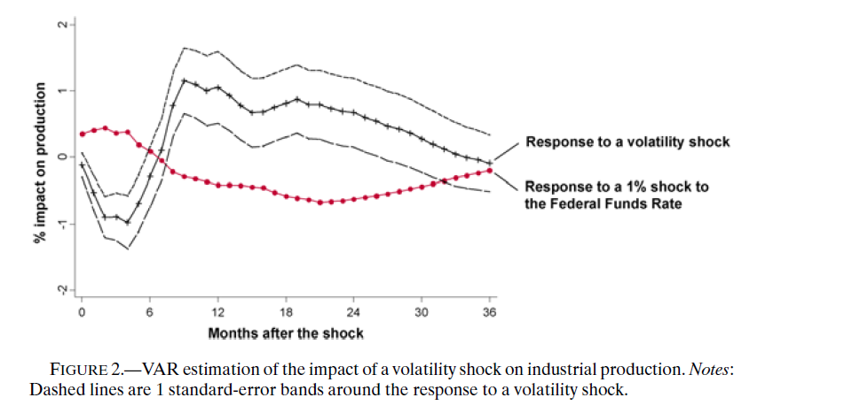
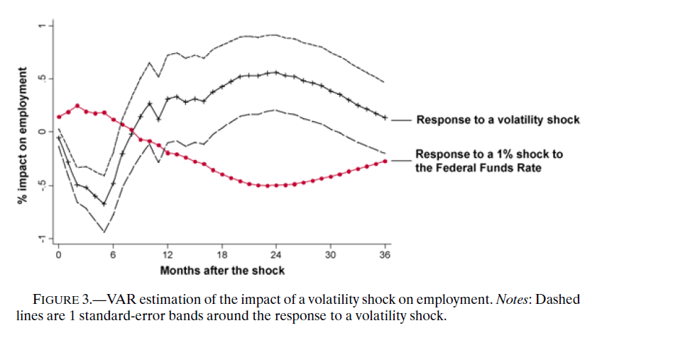
One approach is to use exogenous shocks (Bloom, 2009) and try to control for 1st moment effects
Source: Cholesky VAR estimates using monthly data from June 1962 to June 2008, variables in order include stock-market levels, VIX, FFR, log(ave earnings), log (CPI), hours, log(employment) and log (IP). All variables HP detrended (lambda=129,600). Reults very robust to varying VAR specifications (i.e. ordering, variable inclusion detrending etc).
Source: Bloom (2009)

Slide 62
Another is to use micro-variation in terms of exposure to drivers of uncertainty
Stein and Stone (2012) use energy and currency instruments in firm data finding a large negative impact of uncertainty on investment and hiring (and positive on R&D - growth options)
Baker, Bloom and Davis (2014) look at policy uncertainty and use sector-level in exposure to government (from contracts) and also find a negative impact on investment and hiring
Helpful for causality, but micro data will miss GE macro effects

Slide 63
In summary the literature is suggestive of a negative impact of uncertainty, but is not definitive

Slide 64
My view is uncertainty is both a cause and effect
Some big shock occurs: oil-shock, 9/11, housing crash etc
This combines a negative first moment shock (bad news) and positive second moment shock (increased uncertainty)
As the recession progresses uncertainty rises further, deepening and lengthening the slowdown
Hence, I see uncertainty as both an:
Impulse
Amplification and propagation mechanism

Slide 65
Theory
Measurement
Identification (causality)
Future work

Slide 66
Wide range of open questions
Measurement: of macro and micro uncertainty over time and space (countries, regions, industries and firms).
Impact: identifying cause vs effect
Mechanisms: many theory channels but which matter most?
Computation: include higher-moments in micro-macro models (e.g. Kahn and Thomas; Fernandez-Villaverde, Guerron, Kuester, Rubio-Ramirez and Uribe)

Slide 67
Wide range of open questions
Measurement: of macro and micro uncertainty over time and space (countries, regions, industries and firms).
Impact: identifying cause vs effect
Mechanisms: many theory channels but which matter most?
Computation: include higher-moments in micro-macro models (e.g. Khan and Thomas; Fernandez-Villaverde, Guerron, Kuester, Rubio-Ramirez and Uribe)

Slide 68


One thing I am working on is firm-level surveys
Projecting ahead over the next twelve months, please provide the approximate percentage change in your firm's SALES LEVELS for:
The LOWEST CASE change in my firm’s sales levels would be: -9 %
The LOW CASE change in my firm’s sales levels would be: -3 %
The MEDIUM CASE change in my firm’s sales levels would be: 3 %
The HIGH CASE change in my firm’s sales levels would be: 9 %
The HIGHEST CASE change in my firm’s sales levels would be: 15 %
Numbers in red are the average response from the pilot on 300 firms

Slide 69
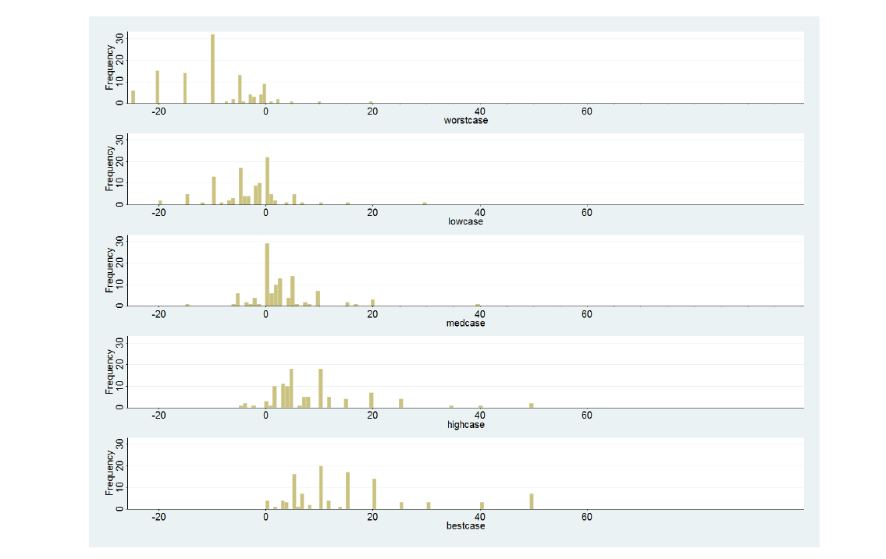

Piloting results look good from testing on a monthly survey on 300 firms: change in sales

Slide 70
One thing I am working on is firm-level surveys
Please assign a percentage likelihood to these SALES LEVEL changes you selected above (values should sum to 100%)
10 % : The approximate likelihood of realizing the LOWEST CASE change
18 % : The approximate likelihood of realizing the LOW CASE change
40 % : The approximate likelihood of realizing the MEDIUM CASE change
23 % : The approximate likelihood of realizing the HIGH CASE change
9 % : The approximate likelihood of realizing the HIGHEST CASE change
Numbers in red are the average response from the pilot on 300 firms

Slide 71
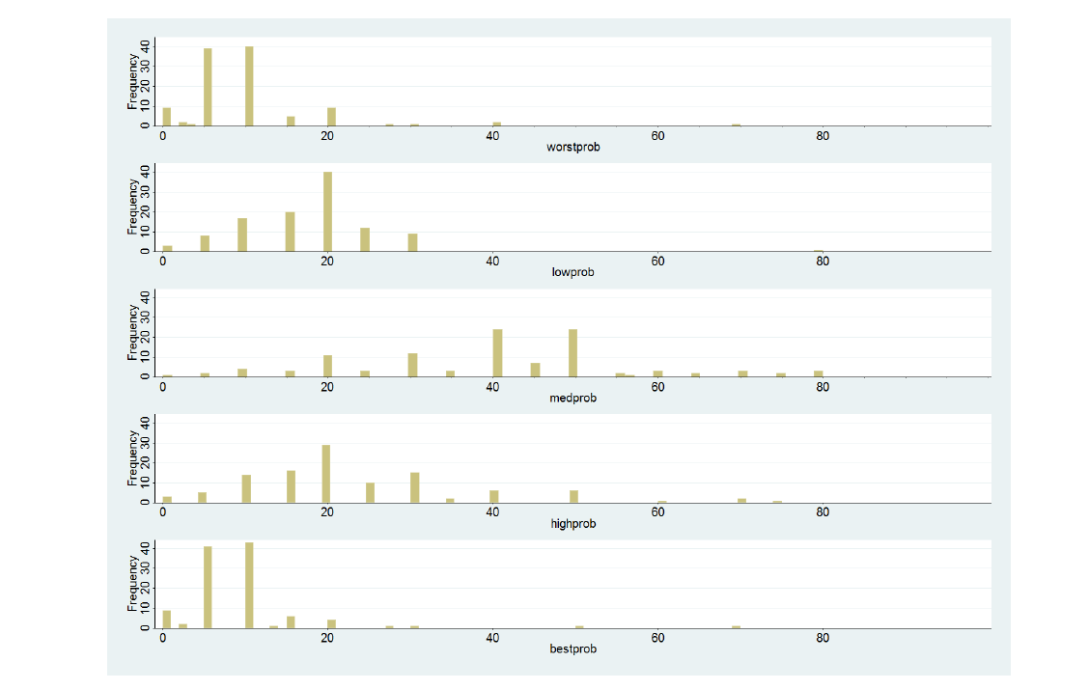
Piloting results look good from testing on a monthly survey on 300 firms: probabilities

Slide 72
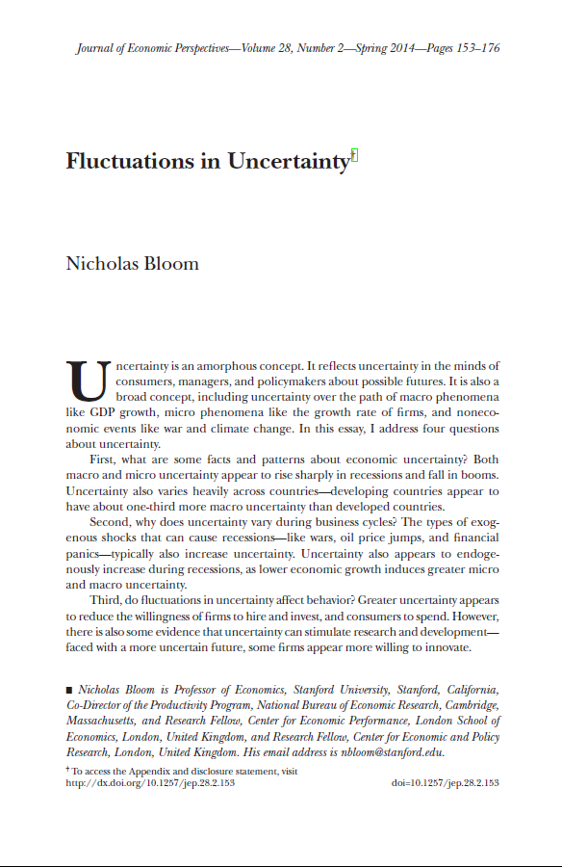
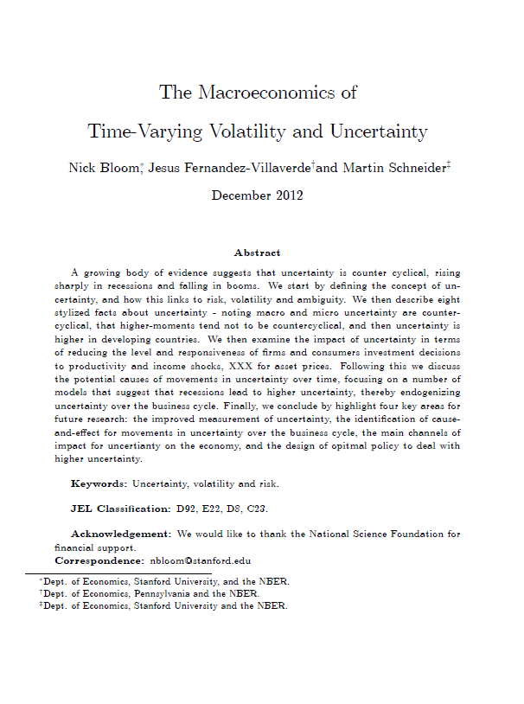
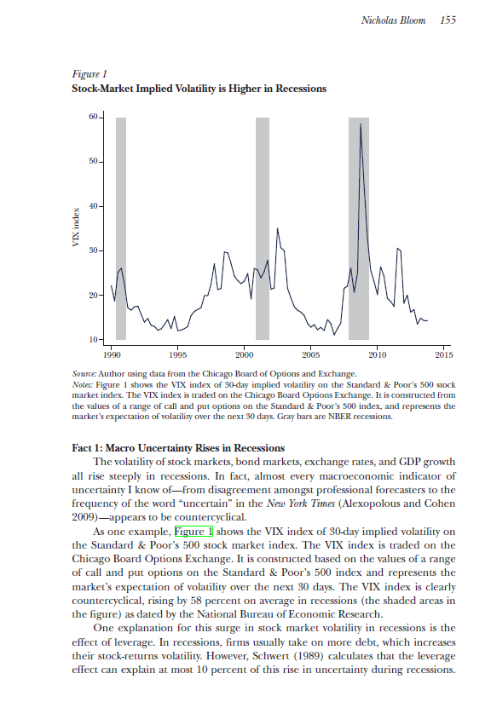
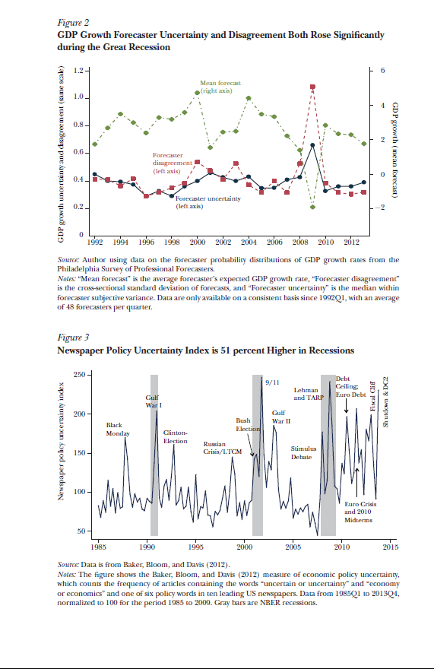
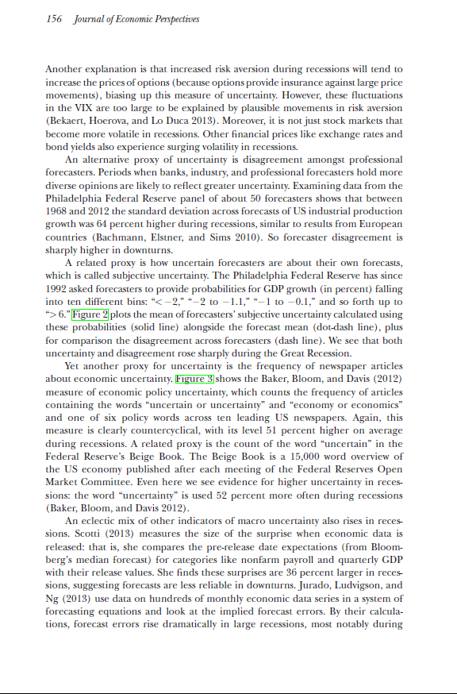
Further reading JEP survey and draft JEL survey (with Fernandez-Villaverde and Schneider)

Slide 73
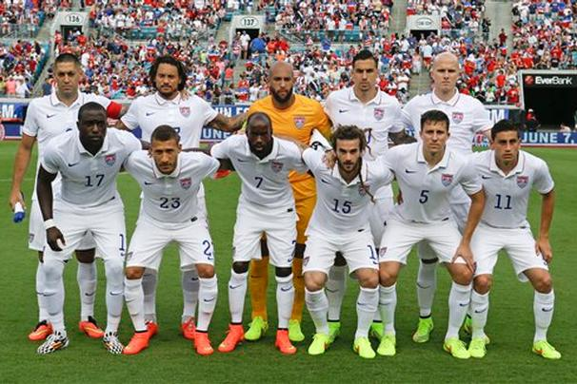
Time-varying uncertainty in macro
Nick Bloom (Stanford & NBER)
SED, June 26th 2014

